Slide 1


Soccer Premier League Analysis
Team Members
Riddhi Sodagar
Vincent DeScioli
Sergio De Souza
Joseph Heresi

Slide 2
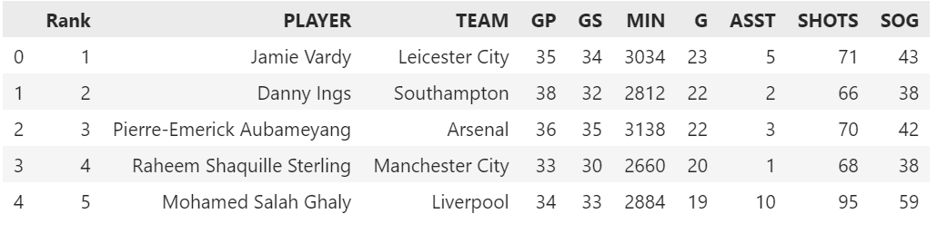
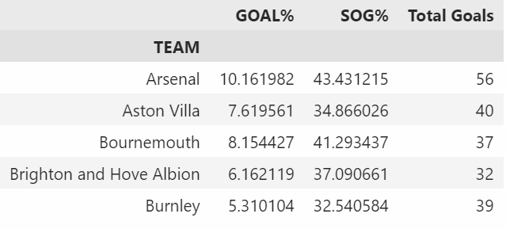
Downloaded data from Kaggle.com for premier league converted data into data frame explained abbreviation
GP = Games Played
GS = Games Scored
MIN = Minutes
ASST = Assist
G = Goal
SOG = Shots on Goal
GOAL% = player_stats_df["G"]/plastats_df["SHOTS"]*100yer_
Shot Accuracy% = player_stats_df["SOG"]/player_stats_df["SHOTS"]*100

Slide 3
Trends for player performance
If top ranked player given more time, will they score more?
Can we find the correlation between top player?
Do top players also contribute to team performance with assist?

Slide 4
Calculating ttest Sample of top50 against all players
st.ttest_1samp(top_players["G"], player_stats_df["G"].mean())
TtestResult(statistic=13.191676278304028, pvalue=9.582897372644606e-18, df=49)
st.ttest_1samp(top_players["ASST"], player_stats_df["ASST"].mean())
TtestResult(statistic=5.616779470676146, pvalue=9.062009171815112e-07, df=49)

Slide 5
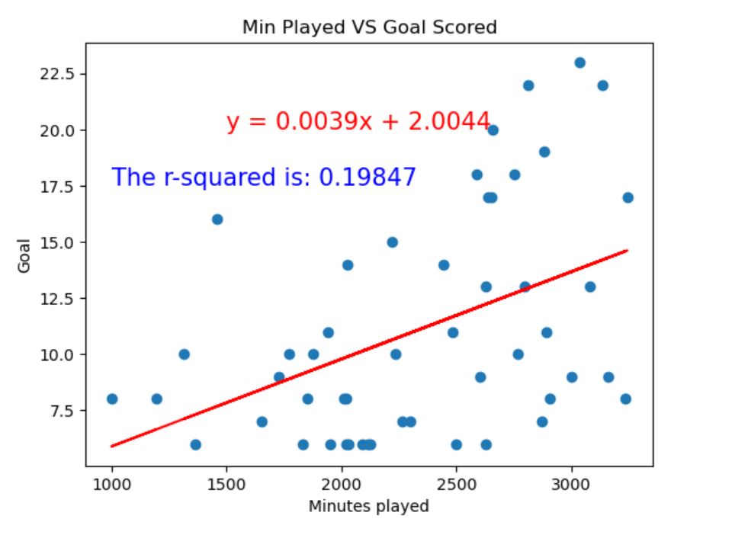
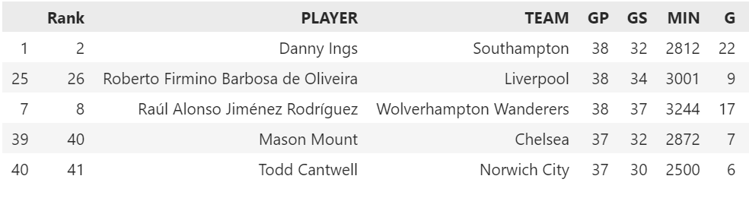
If top ranked player given more time, will they score more?

Slide 6
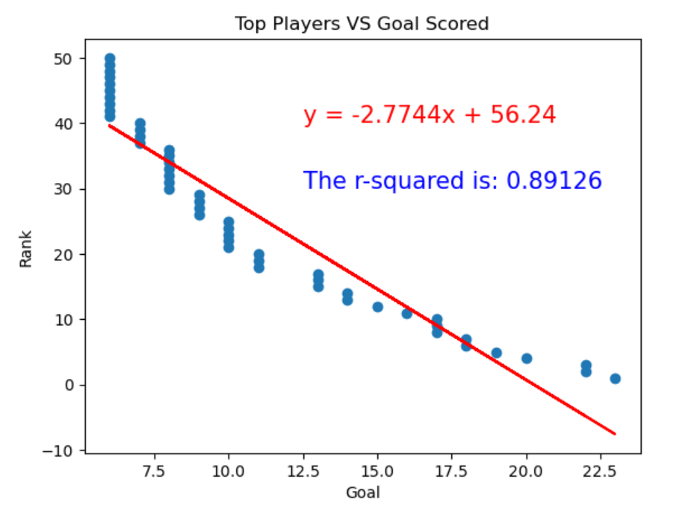
Can we find the correlation between top players?

Slide 7
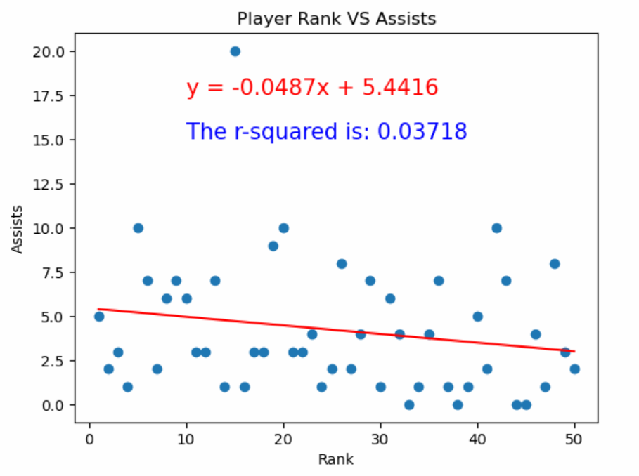
Do top players also contribute to team performance with assist?

Slide 8
Trends in Team Performance
Which team has highest goal %?
Which team has better Shot Accuracy?
Which team had the highest total goal?

Slide 9
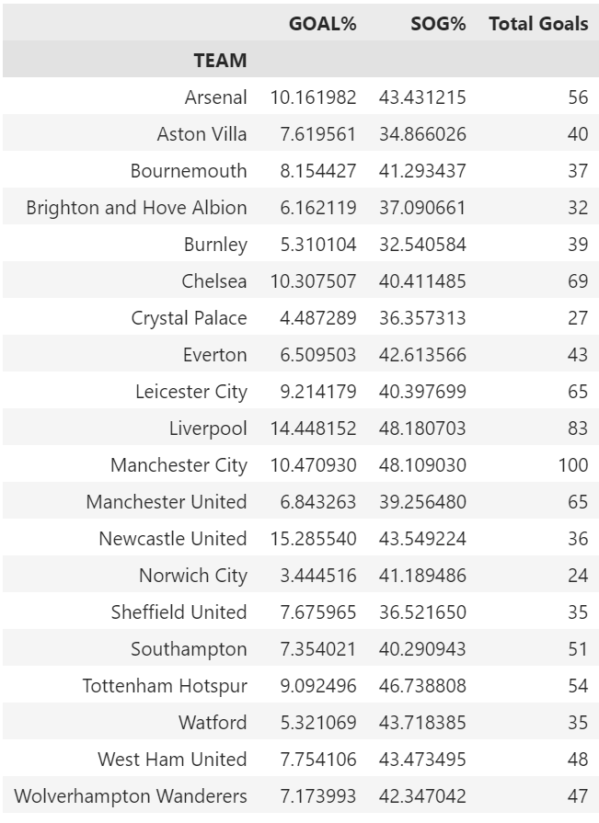
Team average of goal% and SOG%

Slide 10
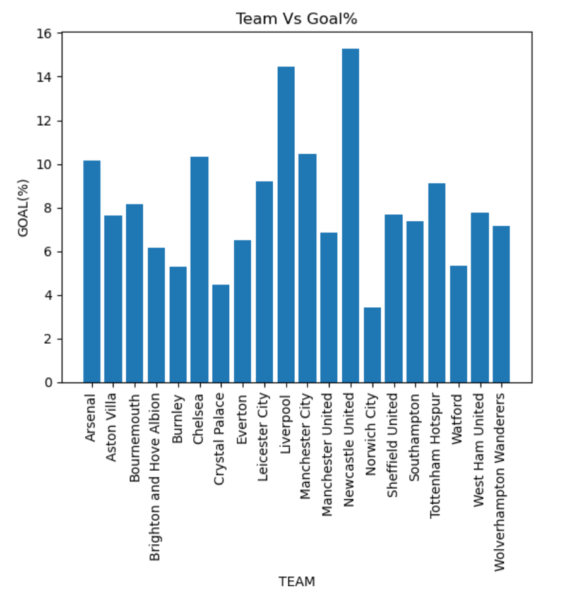
Which team has highest goal %?

Slide 11
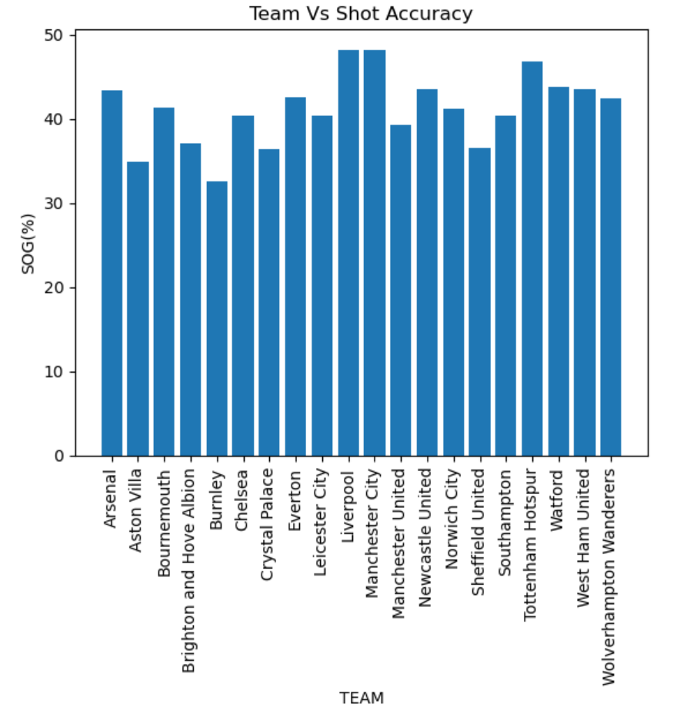
Which team has better Shot Accuracy?

Slide 12
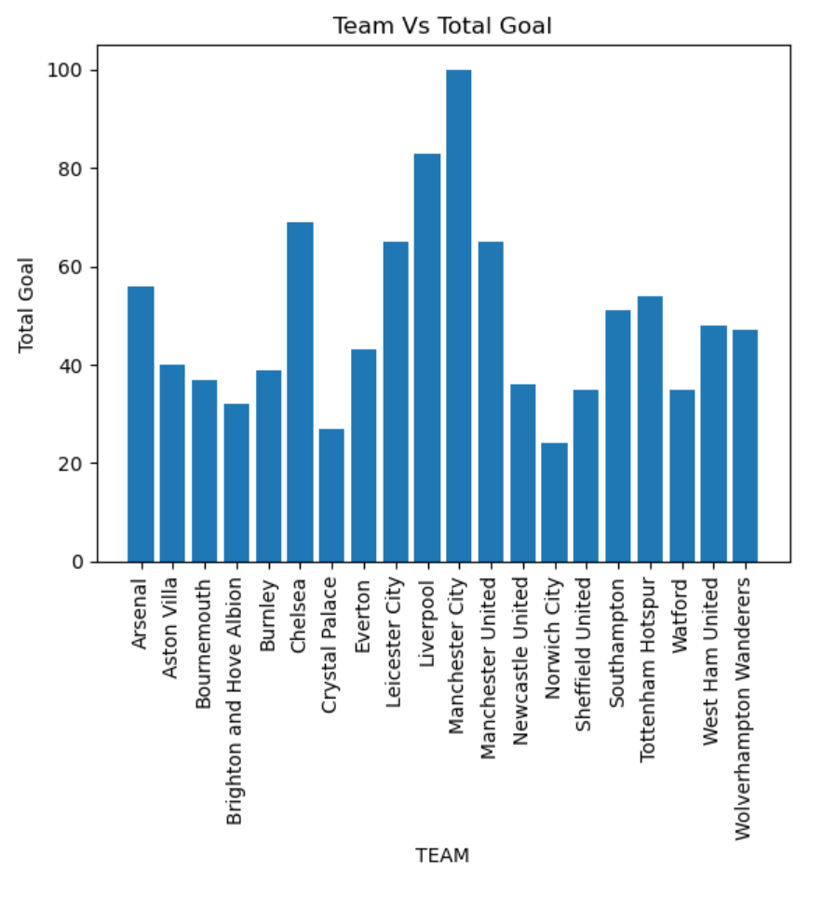
Which team had the highest total goal?

Slide 13
Summary
We have sampled few charts to find the efficiency of the players.
We have done some line regression to see the correlation between Min played VS Goal scored, players vs Goal scored , Player Rank VS Assist.
Created Bar Graph to show the efficiency of the team.
We have done Team Vs Goal, Team Vs Shot Accuracy and Team Vs Total Goal.

Slide 14
What If?
If we were given more financial data, we would have worked on to find out
Which Team gets paid highest?
How the pay affects the players and their efficiency to score goals?
IF we were given more time
We would have dig more to find out how they had ranked these players.
According to the data that we pulled form Kaggle was not sufficient and may not be accurate as well.
Open For Questions:

